Slide 1

EC1002-2: Applied Digital Logic Design
Department of Electronics and Communication Engineering

Slide 2

Basic Bistable Element, SR Flip-Flop, D Flip Flop, JK Flip Flop, T Flip Flop, Master Slave JK Flip Flop, Characteristic Equations, Conversion of Flip Flops.
Sequential Logic Circuits
2

Slide 3
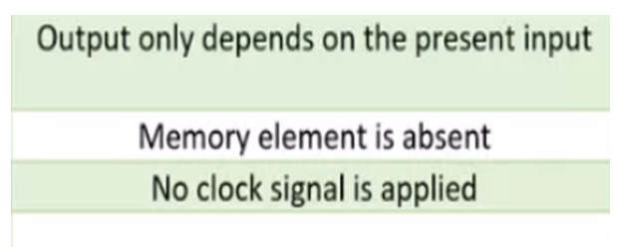
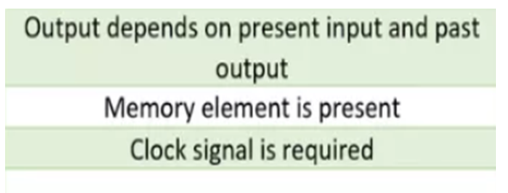
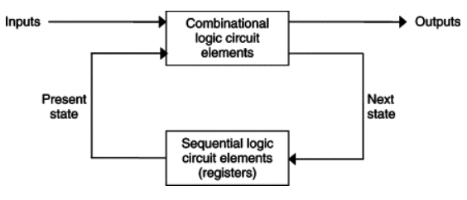
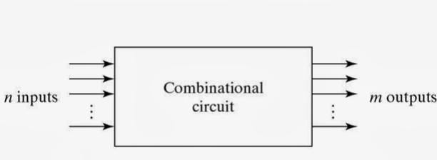
Combinational v/s Sequential

Slide 4
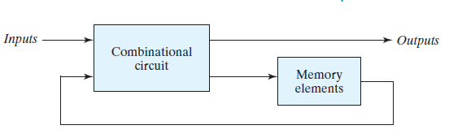
Introduction
The outputs at any instant are dependent not only upon the inputs present at that instant but also upon the past history (or sequence) of inputs
Sequential circuits are said to have memory
All sequential circuits require the existence of feedback

Slide 5
Sequential Circuit Types
A Synchronous Sequential Circuit is one in which its behaviour is determined by the values of signals at only discrete instants of time
Generally have a master-clock that effectively samples the input data to determine network behaviour
An Asynchronous Sequential Circuit is one in which the network is immediately affected by input signal changes.

Slide 6
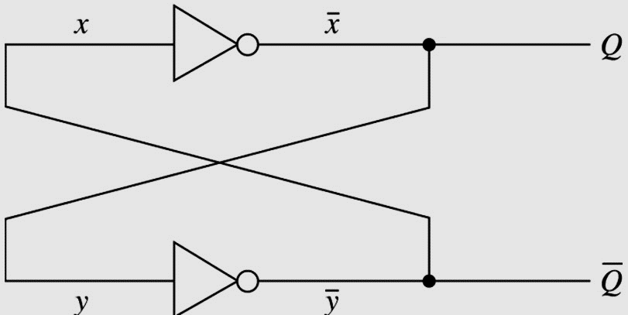
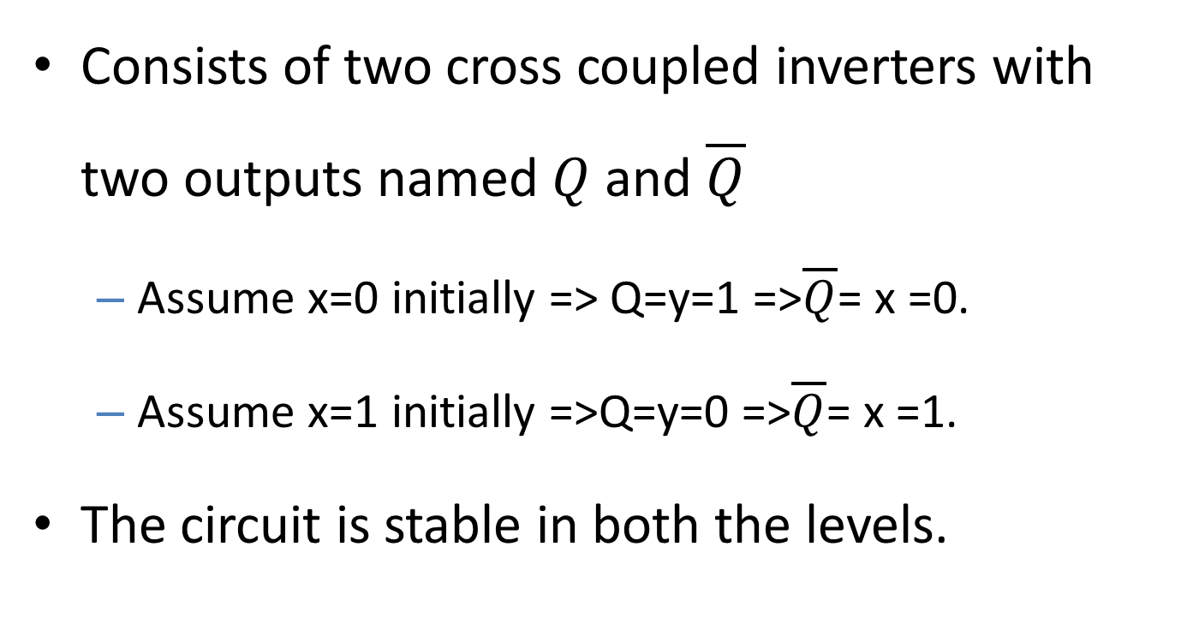
Basic Bistable element
Consists of two cross coupled inverters with two outputs named $Q$and $\overline{Q}$
Assume x=0 initially => Q=y=1 =>$\overline{Q}$= x =0.
Assume x=1 initially =>Q=y=0 =>$\overline{Q}$= x =1.
The circuit is stable in both the levels.

Slide 7
Bistable Element
It is used to store binary symbols.
Stored symbol is referred to as content or state of the element
When the device is storing ‘1’ it is said to be ‘set’ or in ‘1-state’. When storing ‘0’ it is said to be ‘reset’ or in ‘0-state’

Slide 8
Latches
Latch is an electronic logic circuit with two stable states.
Latch has a feedback path to retain the information. Hence a latch can be a memory device.
Latch can store one bit of information as long as the device is powered on.
When enable is asserted, latch immediately changes the stored information when the input is changed i.e. they are level triggered devices. It continuously samples the inputs when the enable signal is on.

Slide 9
Flip-Flop
The Flip-flop remains in a given state as long as the power is applied and until input signal applied causes its output to change.
Inputs to Flip-flop can be of two types
Synchronous or gated inputs: Signal change produces an change in output only when some control signal occurs
Asynchronous or direct inputs: Signal change produces an immediate change in output

Slide 10
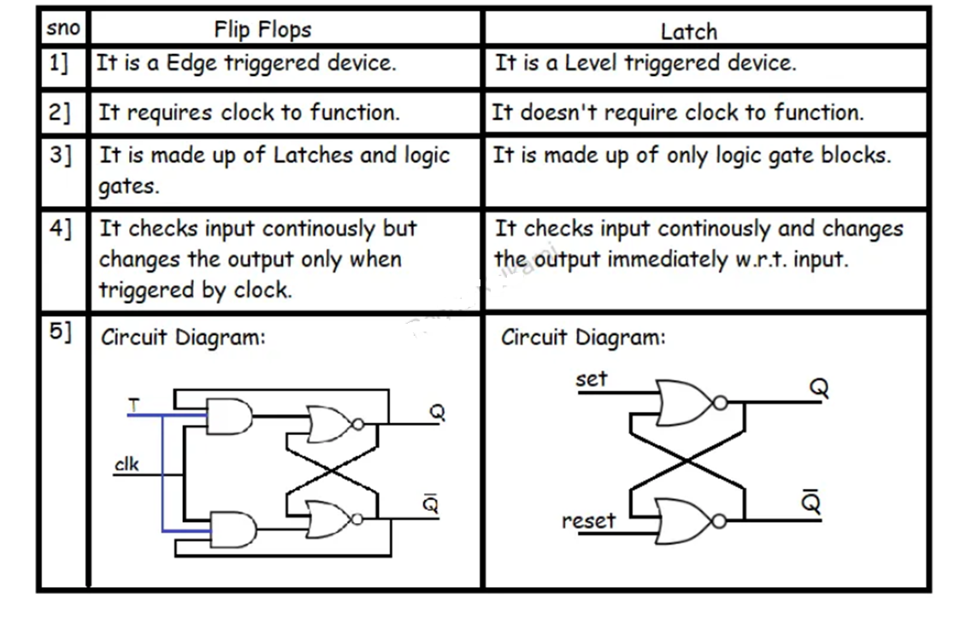
Difference between Latches and Flip Flops

Slide 11
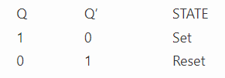
SR Latch
SR: Set-Reset Latch – a circuit with:
2 cross-coupled NOR gates
2 input S for SET and R for RESET
2 output Q, Q’

Slide 12
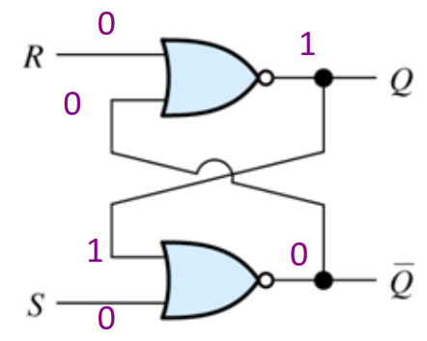
SR Latch Circuit: HOLD/LATCH Mode
S = 0, R = 0; This is the normal resting state of the circuit and it has no effect on the output states. Q and Q’ will remain in whatever state they were in prior to the occurrence of this input condition. It works in HOLD (no change) mode operation.

Slide 13
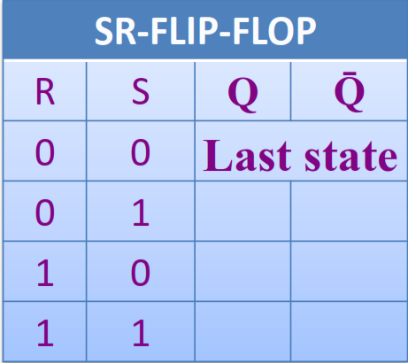
SR Latch Truth Table: HOLD/LATCH Mode

Slide 14
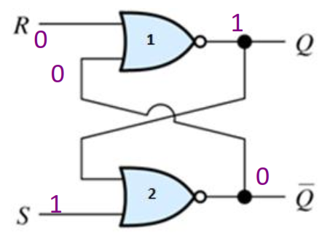
SR Latch Circuit: SET Mode
Consider the input S = 1. Any time the input of a NOR gate is 1 the output is 0. So, the output of the second NOR gate is 0, i.e. Q’ = 0.
Q’ = 0 is fed back into the input of the first NOR gate. So, with R = 0, the output of the first NOR gate is 1, i.e. Q=1.

Slide 15
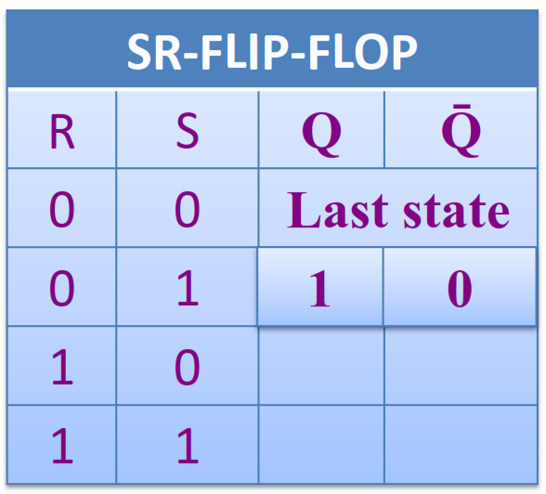
SR Latch Truth Table: SET Mode

Slide 16
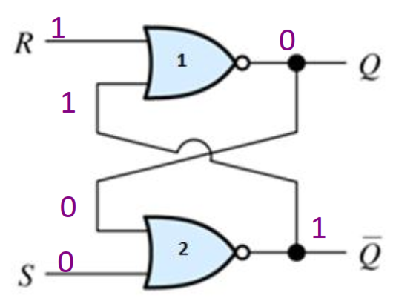
SR Latch Circuit: RESET Mode
Consider the input R = 1. Any time the input of a NOR gate is 1 the output is 0. So, the output of the first NOR gate is 0, i.e. Q = 0.
Q = 0 is fed back into the input of the second NOR gate. So, with S = 0, the output of the second NOR gate is 1, i.e. Q’=1.

Slide 17
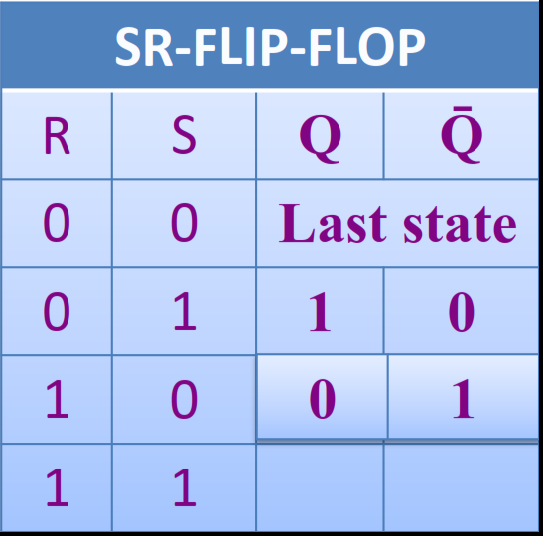
SR Latch Truth Table: RESET Mode

Slide 18
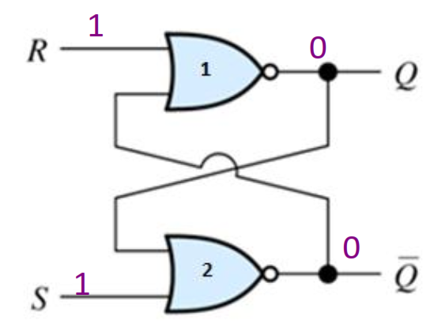
SR Latch Circuit: INVALID Mode
S = 1, R = 1; This condition tries to set and reset the NOR gate latch at the same time, it produces Q = Q’ = 0. This is an unexpected condition and is not used.
The two outputs should be the inverse of each other.

Slide 19
SR Latch Circuit: INVALID Mode
If the inputs are returned to 1 simultaneously, the output states are unpredictable.
This input condition should not be used and when circuits are constructed, the design should make this condition SET=RESET=1 never arises.

Slide 20
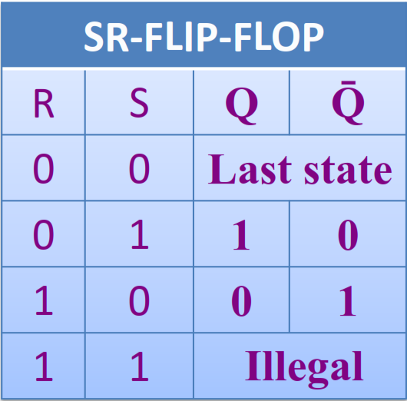
SR Latch Circuit: INVALID Mode

Slide 21
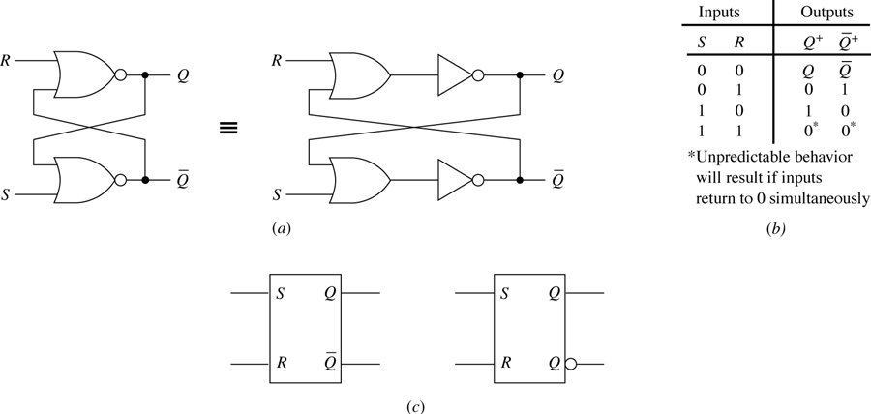

R-S Latch [summary]
Consists of two cross-coupled NOR gates.
2 inputs [R-Reset, S-Set] and 2 outputs [$Q , \overline{Q}$]

Slide 22
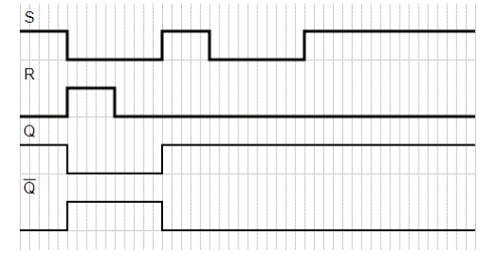
Timing Diagram of SR latch

Slide 23
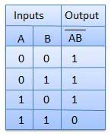

Quick Revision NAND gate & Truth Table:

Slide 24
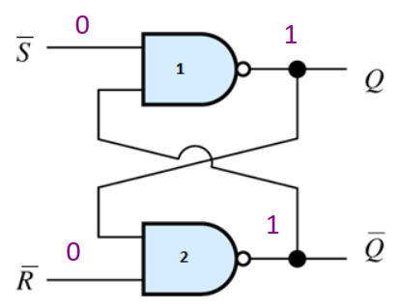
S’R’ Latch Circuit: INVALID Mode
The analysis of a SR Flip Flop NAND:
S = 0, R = 0; This condition tries to set and reset the NAND gate latch at the same time.
It produces Q = Q’ =1

Slide 25
S’R’ Latch Circuit: INVALID Mode
This is an unexpected condition, since the two outputs should be inverses of each other.
If the inputs are returned to 1 simultaneously, the output states are unpredictable.
This input condition should not be used and when circuits are constructed, the designer should make sure that this condition. S=R=0 never arises. It is called INVALID/ PROHIBITED

Slide 26
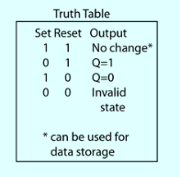
S’R’ Latch Circuit: INVALID Mode

Slide 27
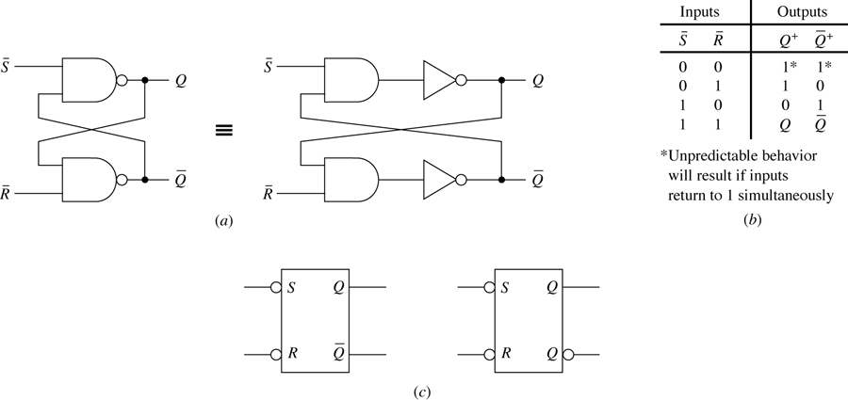


$\overline{S} \overline{R}$ Latch
Consists of two cross-coupled NAND gates.
2 active low inputs and 2 outputs [$Q , \overline{Q}$]

Slide 28
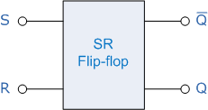
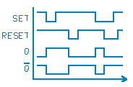
Timing diagram for S’R’ LATCH

Slide 29
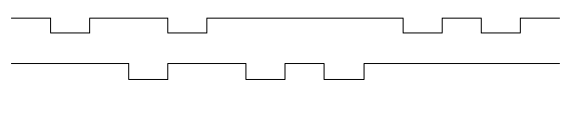
FUNCTION OF SEQUENTIAL LOGIC
Example:
For a given waveform, sketch the output waveform of an active-LOW SR latch.

Slide 30
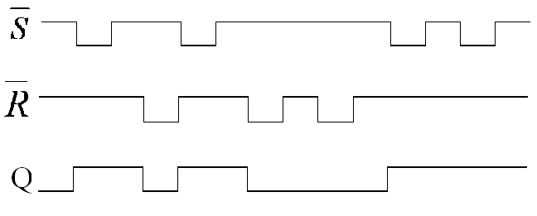
FUNCTION OF SEQUENTIAL LOGIC
Solution:

Slide 31
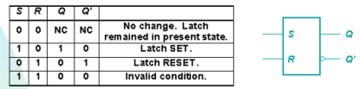
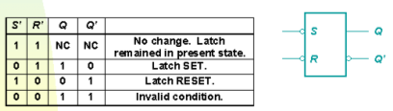
SR Latch
SR with active HIGH input
S’R’ with active LOW input

Slide 32
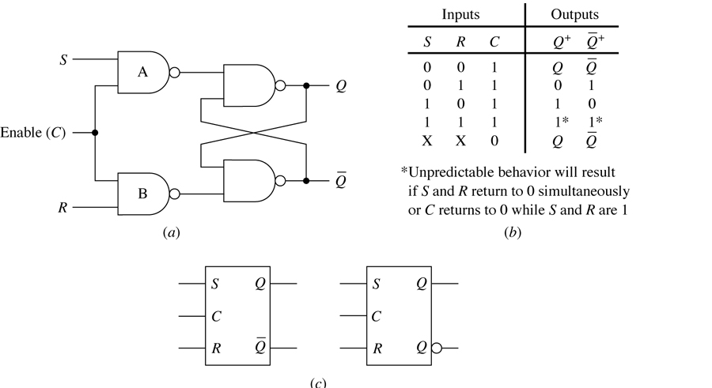
Gated SR Latch
Constructed by adding two Controller NAND gates to the

Slide 33
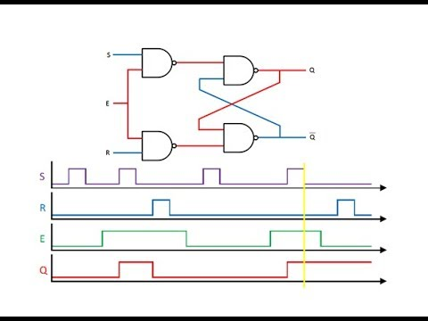

Slide 34
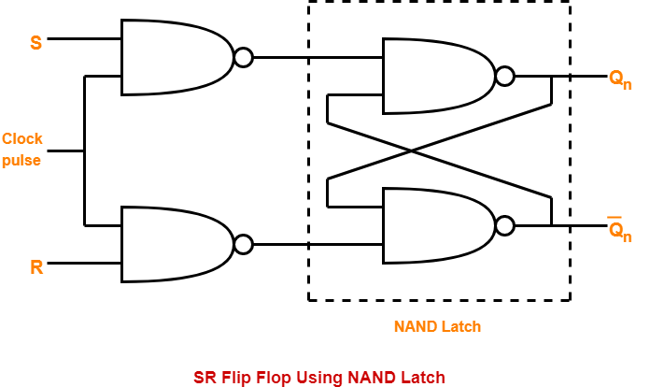
SR flip-flop

Slide 35
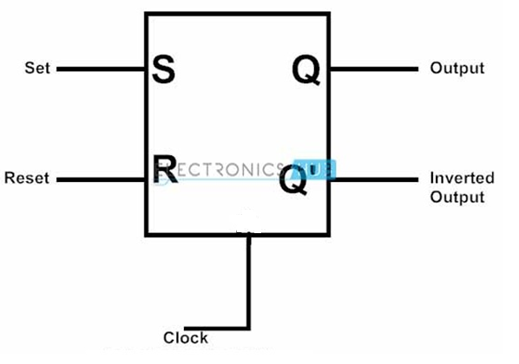
Symbol of SR flip-flop

Slide 36
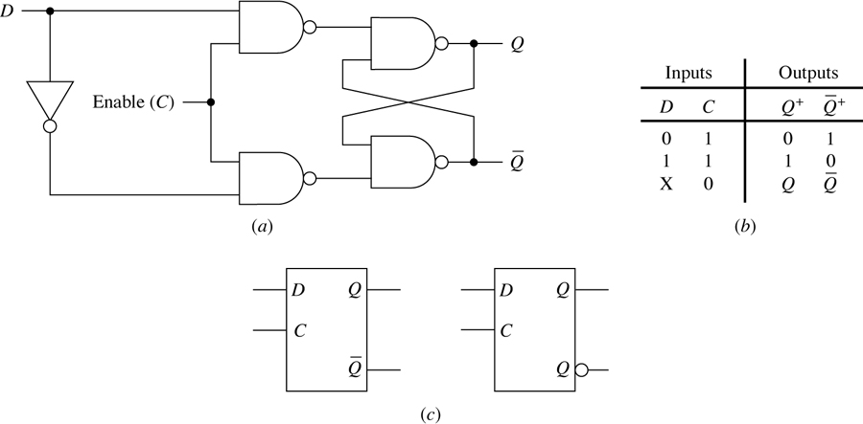

Gated D Latch
Designed to eliminate the forbidden input problem
Single input D and two outputs [$Q , \overline{Q}$]

Slide 37
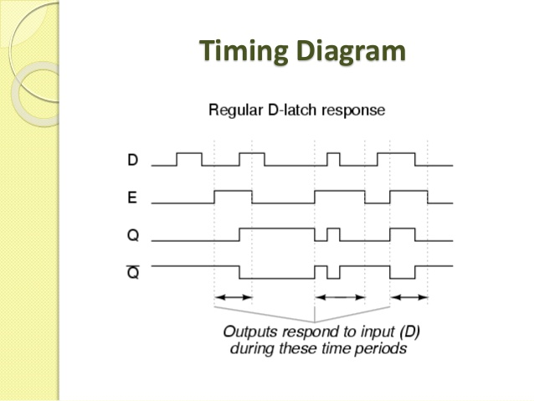

Slide 38
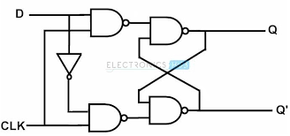
D flip-flop

Slide 39
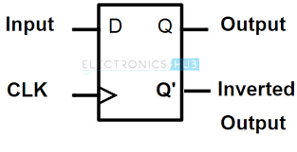
Symbol of D flip-flop

Slide 40
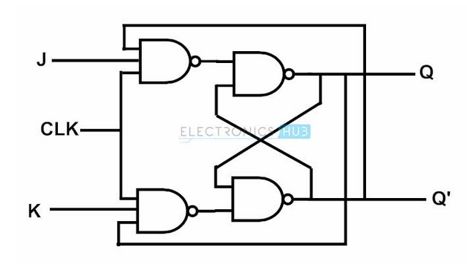
Clocked JK Flip Flop

Slide 41
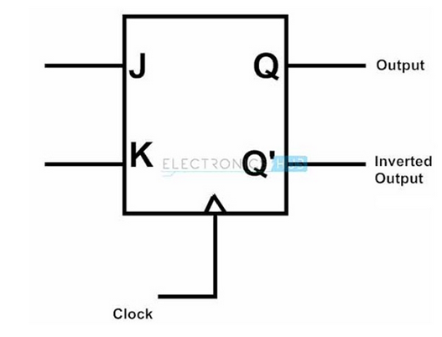
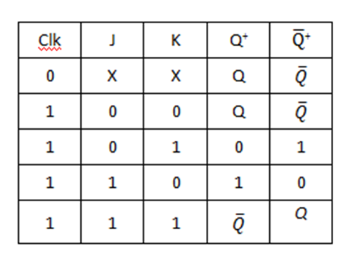
Truth Table

Slide 42
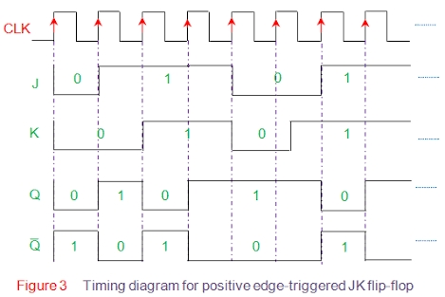

Slide 43
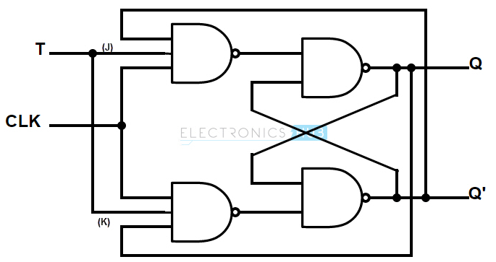
Clocked T-Flip Flop

Slide 44
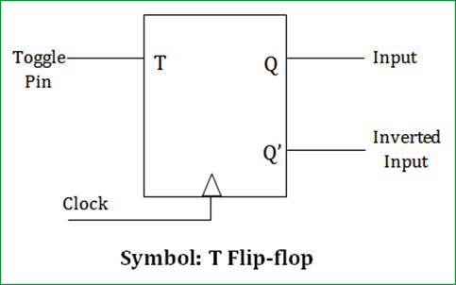
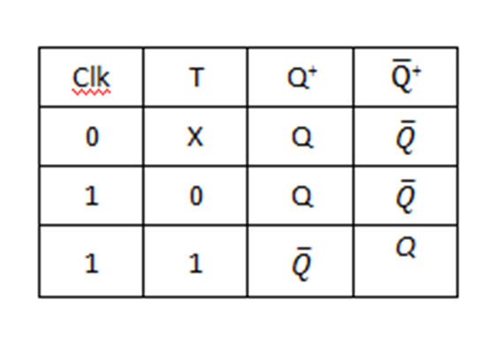
Truth Table

Slide 45
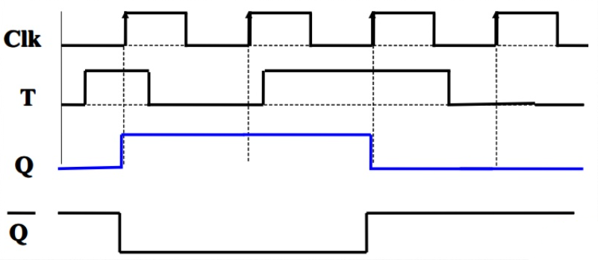
Timing diagram

Slide 46
Master-Slave Flip-Flops
Also known as pulse-triggered flip-flops
Necessary in case where it is necessary to sense current state while allowing new state information to be entered.
It consists of two cascaded sections.
First section is the master and the second is the slave
Information is entered into the master on one edge or level of a control signal and is transferred to the slave on the next edge or level of control signal

Slide 47
Master-Slave JK Flip-Flop
In this J corresponds to S and K corresponds to R inputs.
J=K=1 causes the flip-flop to toggle from the current state.
If present state is 1 then next state is 0
If present state is 0 then next state is 1
In this 2 AND gates are used to sense and steer the state of the slave [in addition to SR MS flip-flop]

Slide 48
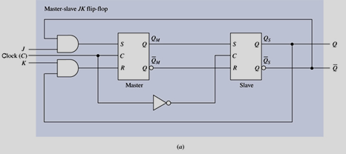
Master-Slave JK Flip-Flop

Slide 49
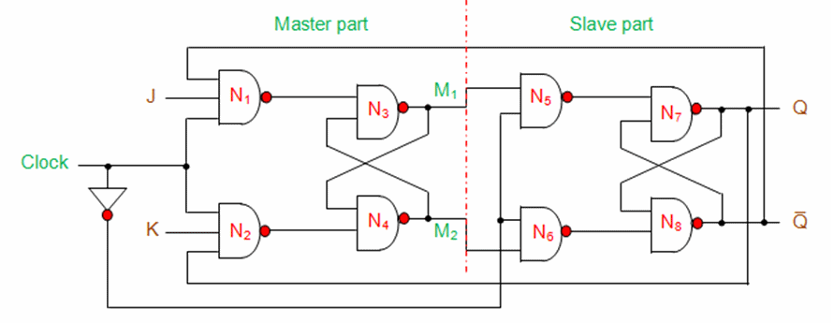
Master Slave Flip Flop using NAND gates

Slide 50


Slide 51


Slide 52

Timing Diagram for JK MS Flip-Flop

Slide 53
Triggering
Triggering means making the circuit active [allow it to receive inputs]
Triggering makes a circuit synchronous
Triggering is given in the form of clock or gate signal
Depending on the type of triggering used circuit becomes active at specific states of clock pulse
Level Triggering: Circuit becomes active when gating or clock pulse is at a particular level
Edge Triggering: Circuit becomes active at the negative edge or positive edge of the clock signal

Slide 54
Edge Triggered Flip-Flops
Uses just one of the edges of the control to affect the reading of information on input lines.
Designed to use either the positive or negative edge of the clock.
Once triggering edge occurs the flip-flop remains unresponsive to information input changes until the next triggering edge.

Slide 55

Positive Edge Triggered D Flip-Flop
Setting or Resetting of the flip-flop is established by the rising, or positive, edge of the control signal.

Slide 56

Negative Edge Triggered D Flip-Flop
Falling edge is used to sample the D input .
Achieved by using an inverter at the control input of the flip-flop.

Slide 57
Characteristic Equations
Algebraic description of the next state table of a flip-flop.
Obtained by constructing the K-Map for Q+ in terms of present state and information input variables.

Slide 58


Slide 59

Next state table of SR flip-flop

Slide 60

Characteristic equation of SR flip-flop

Slide 61

Next state table of JK flip-flop

Slide 62

Characteristic equation of JK flip-flop

Slide 63

Next state table of D flip-flop

Slide 64

Characteristic equation of D flip-flop

Slide 65

Next state table of T flip-flop

Slide 66

Characteristic equation of T flip-flop

Slide 67

Conversion of Flip-Flops

Slide 68
JK Flip-flop to D Flip-flop
Required -D : write next table
Available –JK: write excitation table
Next State Table
Next State Table
J | K | Q | Q⁺
0 | 0 | 0 | 0
0 | 0 | 1 | 1
0 | 1 | 0 | 0
0 | 1 | 1 | 0
1 | 0 | 0 | 1
1 | 0 | 1 | 1
1 | 1 | 0 | 1
1 | 1 | 1 | 0
D | Q | Q⁺
0 | 0 | 0
0 | 1 | 0
1 | 0 | 1
1 | 1 | 1
Application Table
Q | Q⁺ | J | K
0 | 0 | 0 | X
0 | 1 | 1 | X
1 | 0 | X | 1
1 | 1 | X | 0

Slide 69

Conversion of J-K Flip-Flop into D Flip-Flop
Step-1: We construct the characteristic table of D flip-flop and excitation table of JK flip-flop.

Slide 70

Conversion of J-K Flip-Flop into D Flip-Flop
Step-2: Using the K-map we find the boolean expression of J and K in terms of D.
J = D K = D'

Slide 71

Conversion of J-K Flip-Flop into D Flip-Flop
Step-3: We construct the circuit diagram of the conversion of JK flip-flop into D flip-flop.

Slide 72
JK Flip-flop to T Flip-flop
Required -T : write next table
Available –JK: write excitation table
Next State Table
J | K | Q | Q⁺
0 | 0 | 0 | 0
0 | 0 | 1 | 1
0 | 1 | 0 | 0
0 | 1 | 1 | 0
1 | 0 | 0 | 1
1 | 0 | 1 | 1
1 | 1 | 0 | 1
1 | 1 | 1 | 0
T | Q | Q⁺
0 | 0 | 0
0 | 1 | 1
1 | 0 | 1
1 | 1 | 0
Application Table
Q | Q⁺ | J | K
0 | 0 | 0 | X
0 | 1 | 1 | X
1 | 0 | X | 1
1 | 1 | X | 0

Slide 73

Conversion of J-K Flip-Flop into T Flip-Flop
Step-1: We construct the characteristic table of T flip-flop and excitation table of JK flip-flop.

Slide 74

Conversion of J-K Flip-Flop into T Flip-Flop
Step-2: Using the K-map we find the boolean expression of J and K in terms of T.
J = T K = T

Slide 75

Conversion of J-K Flip-Flop into T Flip-Flop
Step-3: We construct the circuit diagram of the conversion of JK flip-flop into T flip-flop.

